Slide 2
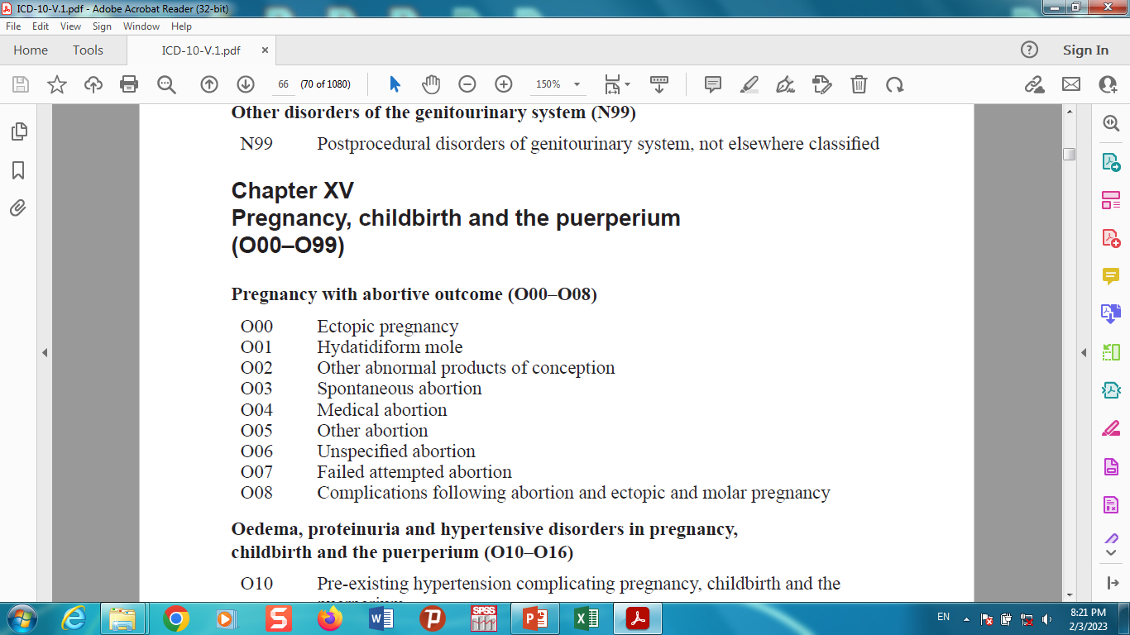

Slide 3
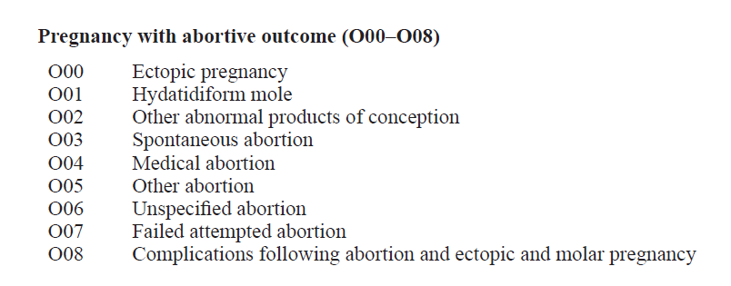
Pregnancy, childbirth and the puerperium

Slide 4
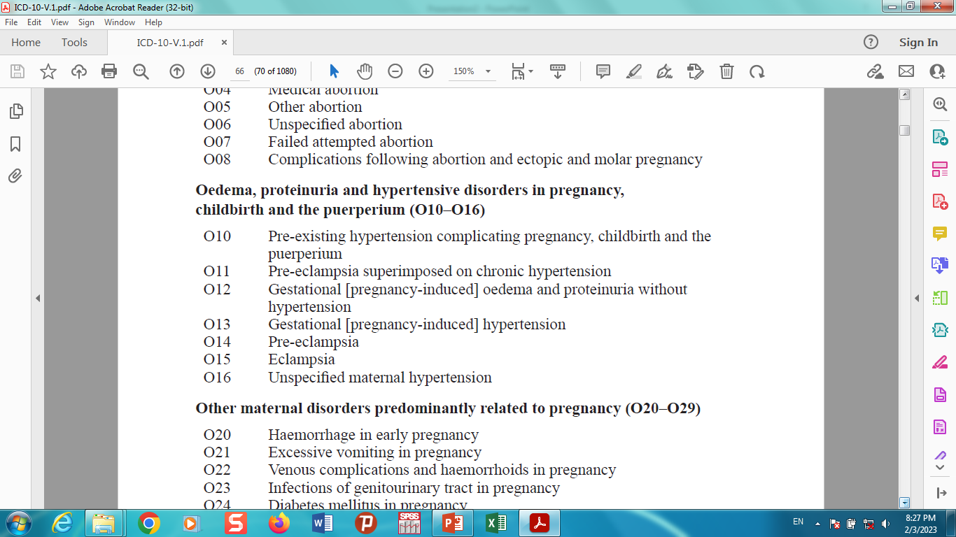
Pregnancy, childbirth and the puerperium

Slide 5
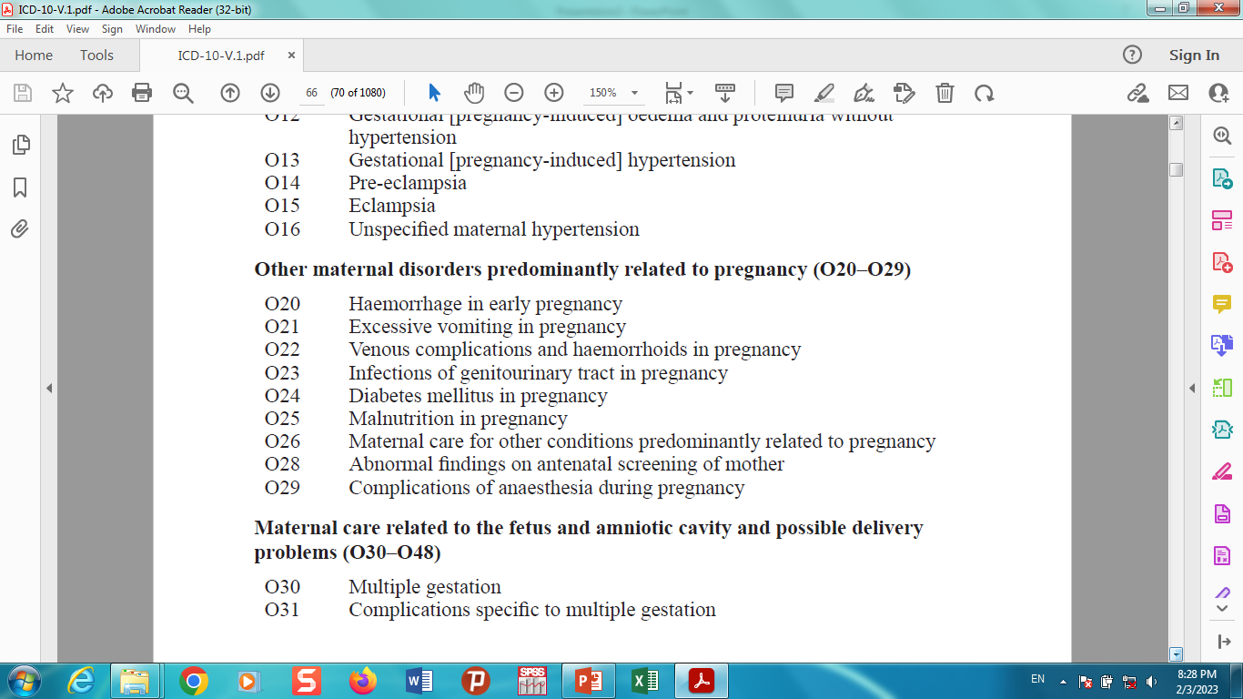
Pregnancy, childbirth and the puerperium

Slide 6
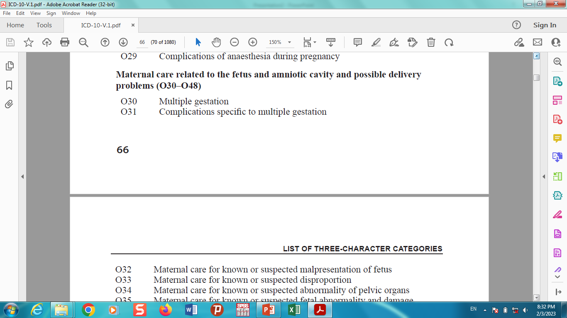
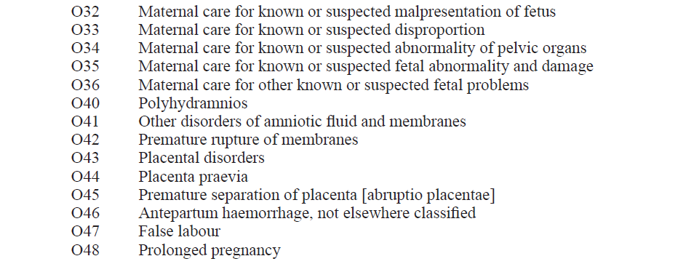
Pregnancy, childbirth and the puerperium

Slide 7
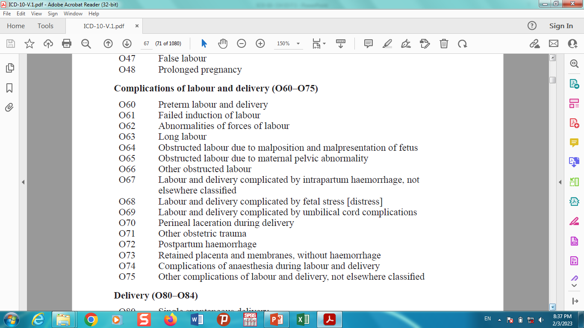
Pregnancy, childbirth and the puerperium

Slide 8
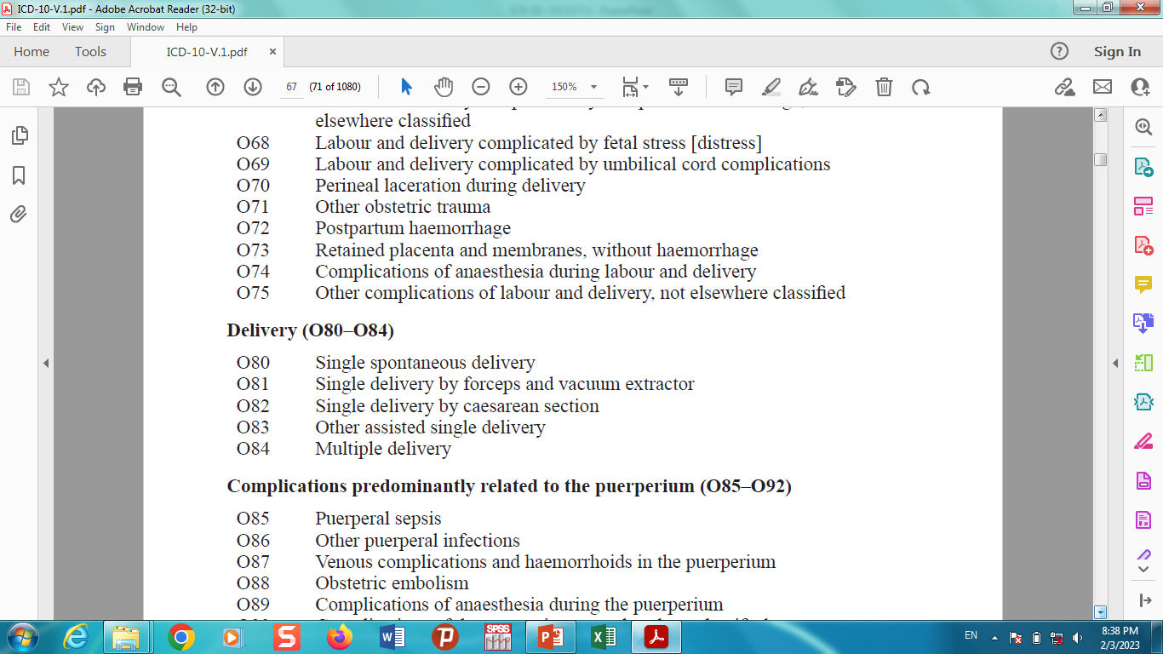
Pregnancy, childbirth and the puerperium

Slide 9
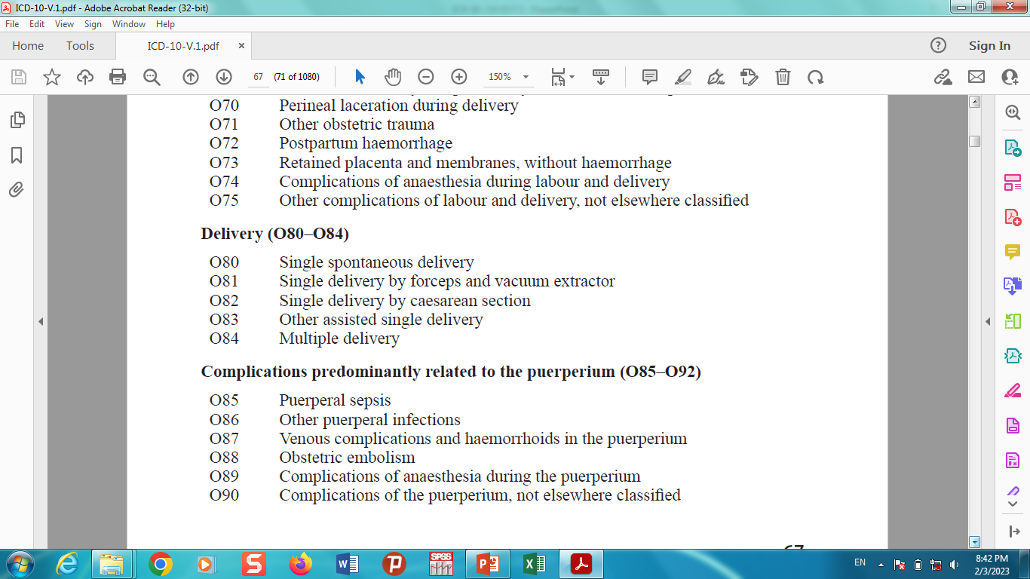
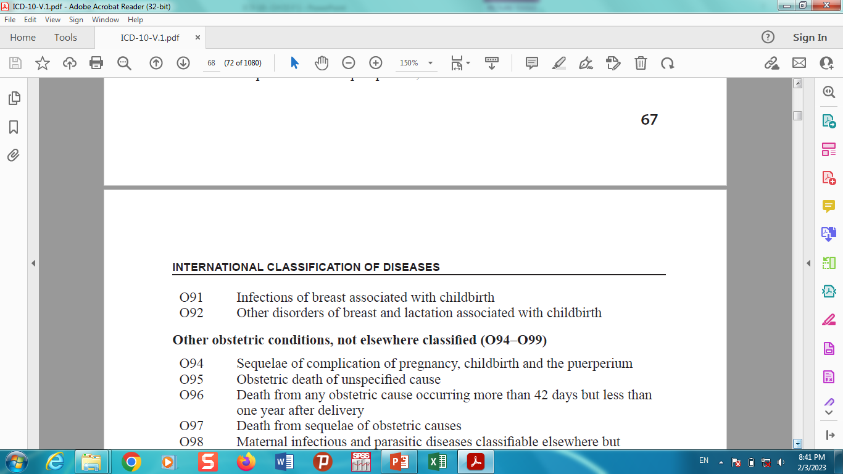
Pregnancy, childbirth and the puerperium

Slide 10
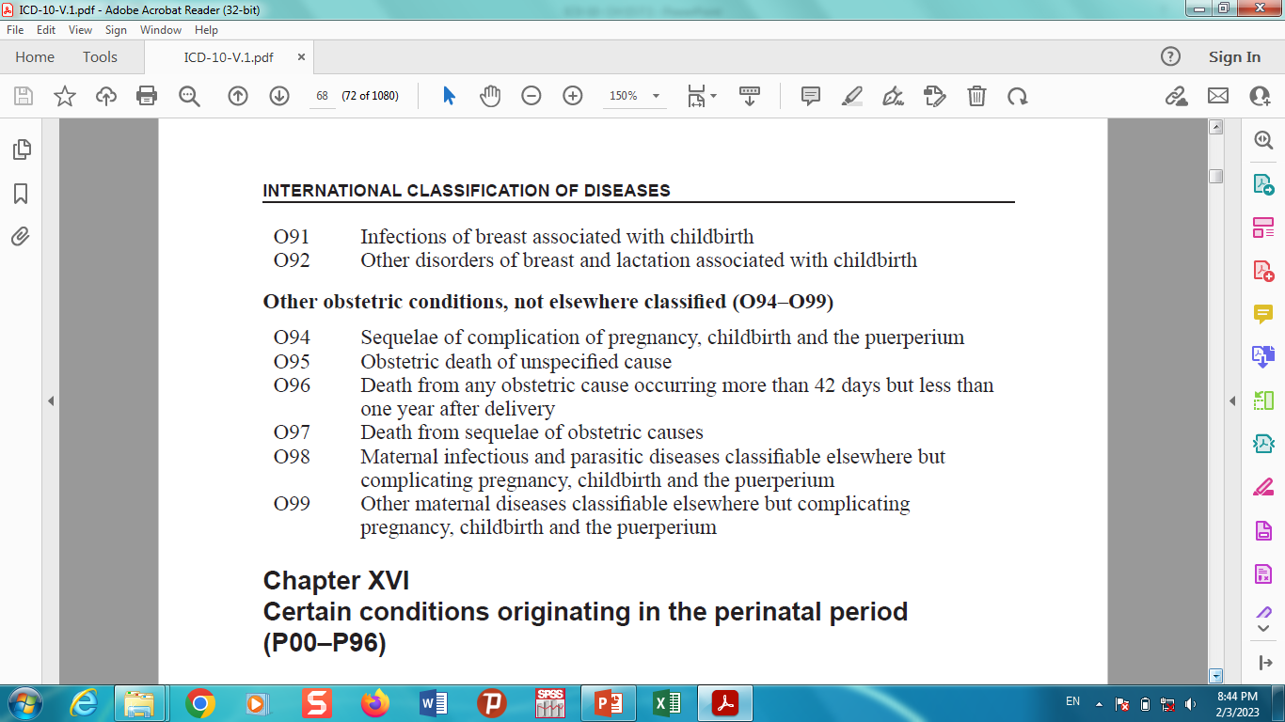
Pregnancy, childbirth and the puerperium

Slide 11


Slide 12
Pregnancy with abortive outcome (O00–O08)

Slide 13

Ectopic Pregnancy( O00 )
An ectopic pregnancy occurs when a fertilized egg implants and grows outside the main cavity of the uterus.
An ectopic pregnancy most often occurs in a fallopian tube, which carries eggs from the ovaries to the uterus.
This type of ectopic pregnancy is called a tubal pregnancy.

Slide 14
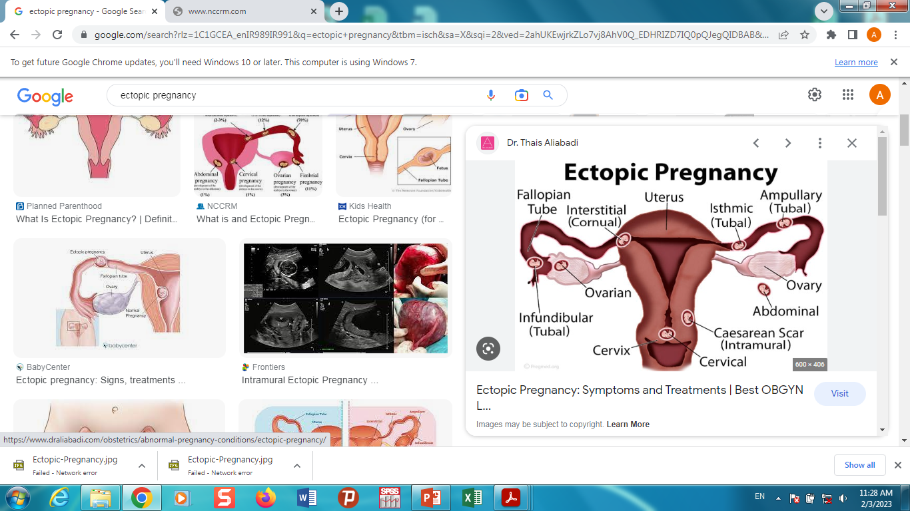
ectopic pregnancy

Slide 15
Ectopic Pregnancy
Case 1
بیمار خانم 27ساله با سابقه بارداری G2P1L1 بعلت درد شکم مراجعه کرده است که بعداز اقدامات بالینی وپاراکلنیکی متوجه حاملگی خارج ازرحم شده است.

Slide 16
Hydatidiform Mole (HM)
Hydatidiform mole (HM) is a rare mass or growth that forms inside the womb (uterus) at the beginning of a pregnancy.
It is a type of gestational trophoblastic disease (GTD).

Slide 17
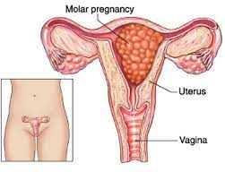
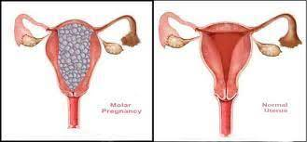
Hydatidiform Mole (HM)

Slide 18
Hydatidiform Mole (HM)
Case 1
بیمار خانم 17ساله PGبا شکایت درد شکم به مرکز درمانی مراجعه کرده است پس از انجام اقدامات بالینی وپاراکلنیکی متوجه مولار پرگننسی شده اند.

Slide 19
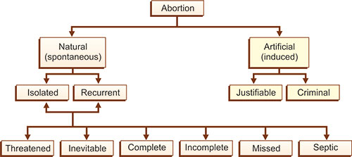
Abortion

Slide 20
threatened abortion
A threatened abortion is defined as vaginal bleeding before 20 weeks gestational age in the setting of a positive urine and/or blood pregnancy test with a closed cervical os.
without passage of products of conception
without evidence of a fetal or embryonic demise(IUFD).

Slide 21
Inevitable abortion
Inevitable abortion is an early pregnancy with vaginal bleeding and dilatation of the cervix.
Typically, the vaginal bleeding is worse than with a threatened abortion, and more cramping is present.
Symptoms cannot be stopped and a miscarriage will happen.

Slide 22
Inevitable abortion
Bleeding is heavier than with a threatened miscarriage and abdominal cramps more severe.
Unlike threatened miscarriage, an inevitable miscarriage is also accompanied by dilation of the cervical canal.

Slide 23
complete miscarriage/complete abortion
A complete miscarriage, also called a complete abortion,
refers to a miscarriage in which all of the pregnancy tissue is expelled from the uterus.
Signs & Symptoms: A complete miscarriage is characterized by heavy vaginal bleeding, severe abdominal pain, and passage of pregnancy tissue.

Slide 24
incomplete abortion
An incomplete abortion is the partial loss of the products of conception within the first 20 weeks.
Complete abortion: All of the products (tissue) of conception leave the body. Incomplete abortion: Only some of the products of conception leave the body.

Slide 25
Incomplete abortion
Incomplete abortion usually presents with moderate to severe vaginal bleeding, which may be associated with lower abdominal and/or pelvic pain.
It is important to diagnose this early to make sure the patient expels all products of conception.

Slide 26
Missed abortion
Missed abortion is when a pregnancy stops developing, where the embryo/fetus/embryonic tissue or empty gestation sac remains in the uterus and the cervical os is closed.
Symptoms may include pain, bleeding or no symptoms at all.
The pregnancy is lost and the products of conception do not leave the body.

Slide 27
Missed abortion
A missed abortion is a miscarriage in which your fetus didn’t form or has died, but the placenta and embryonic tissues are still in your uterus.
It’s known more commonly as a missed miscarriage. It’s also sometimes called a silent miscarriage.
A missed abortion gets its name because this type of miscarriage doesn’t cause symptoms of bleeding and cramps that occur in other types of miscarriages.
This can make it difficult for you to know that the loss has occurred.

Slide 28
Infected (septic) abortion
Infected (septic) abortion: The lining of the womb (uterus) and any remaining products of conception become infected.
Septic abortion refers to any abortion, spontaneous or induced, that is complicated by uterine infection, including endometritis.
Septic abortion typically refers to pregnancies of less than 20 weeks gestation while those ≥20 weeks gestation with intrauterine infection are described as having intraamniotic infection.

Slide 29
Failed attempted abortion
When an abortion fails to terminate the pregnancy, it is called a failed abortion.
In some cases, the baby will keep growing.
In other cases, only parts of the pregnancy remain.
ICD-10 code O07. 4 for Failed attempted termination of pregnancy without complication

Slide 30
abortion
Case 1
بیمار خانم 20ساله باسابقه باداری G3P2L2باسن حاملگی 19هفته دچار خونریزی شده است وبه مرکز درمانی مراجعه کرده است.

Slide 31
abortion
Case 2
بیمار خانم 28ساله باسابقه بارداری G4P2L2EP1باسن حاملگی 21هفته پس از مصرف داروهای سقط جنین باشکایت خونریزی ودرد شکم به مرکزدرمانی مراجعه کرده است.

Slide 32
abortion
Case 3
بیمار خانم 20ساله PGبا سن حاملگی 20هفته با دردست داشتن نامه از پزشک قانونی جهت انجام سقط به مرکز درمانی مراجعه کرده است.

Slide 33
abortion
Case 4
بیمار خانم 30ساله با سابقه بارداریG4P3L2D1با سن حاملگی 21هفته که پس از اقدام به سقط درمنزل به مرکز درمانی مراجعه میکند پس از بررسی های بعمل آمده متوجه میشوند که سقط انجام نشده وجنین زنده میباشد .

Slide 35
Oedema, proteinuria and hypertensive disorders in pregnancy, childbirth and the puerperium (O10–O16)

Slide 36
Pre-eclampsia
Pre-eclampsia is a serious medical condition that can occur after 20 weeks of pregnancy.
It typically causes high blood pressure and can affect several of your body organs, including the liver, kidney and brain.
If left untreated, it can lead to serious problems for you or your baby.

Slide 37
Pre-eclampsia
preeclampsia signs and symptoms may include:
  high blood pressure
  Excess protein in urine (proteinuria) or other signs of kidney problems.
  Decreased levels of platelets in blood (thrombocytopenia)
  Increased liver enzymes that indicate liver problems.

Slide 38
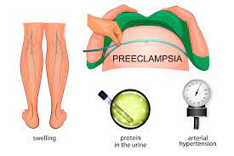
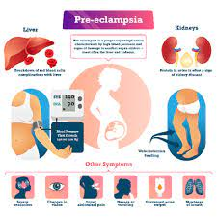
Pre-eclampsia

Slide 39
Eclampsia
Eclampsia is a severe complication of preeclampsia.
It's a rare but serious condition where high blood pressure results in seizures during pregnancy.
Seizures are periods of disturbed brain activity that can cause episodes of staring, decreased alertness, and convulsions (violent shaking).
It usually develops in the late second trimester or the third trimester.

Slide 40
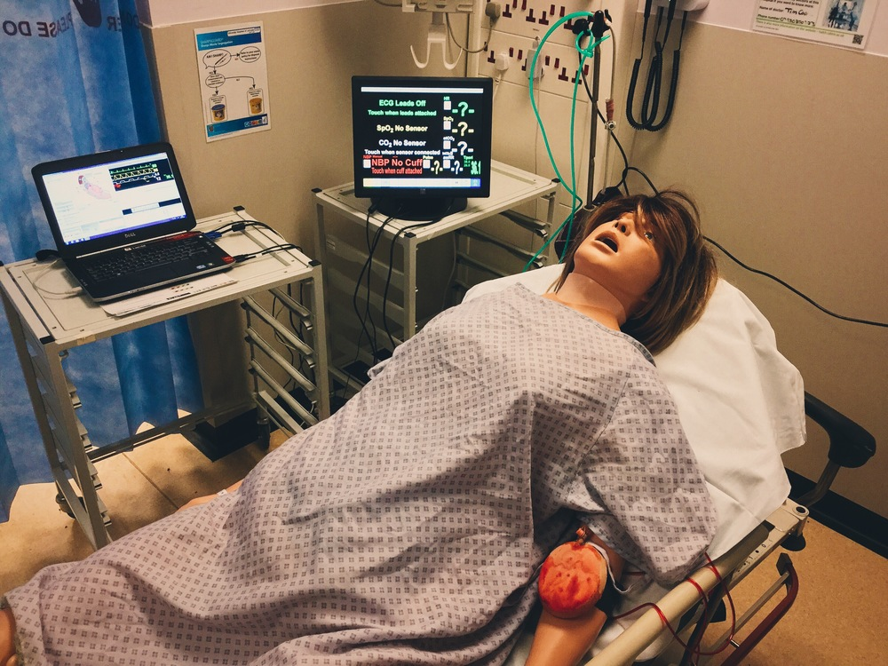
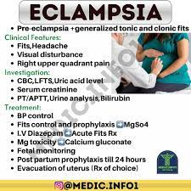
Eclampsia

Slide 41
Preeclampsia and eclampsia
Eclampsia typically develops from preeclampsia.
High blood pressure (from preeclampsia) puts pressure on your blood vessels. There can be swelling in your brain, which may lead to seizures. Genetics and diet can increase your risk for eclampsia.
Preeclampsia and eclampsia are pregnancy-related high blood pressure disorders.
Preeclampsia is a sudden spike in blood pressure. Eclampsia is more severe and can include seizures or coma.

Slide 42
Pre-existing & Gestational [pregnancy-induced]
Pre-existing hypertension
And
Gestational [pregnancy-induced] oedema and proteinuria

Slide 43
فشار خون بارداری
بیمار خانم 25ساله PGمیباشد که بدلیل فشار خون بارداری پذیرش وبستری شده است
بیمار خانم 22ساله با سابقه بارداری G2AB1 باسابقه فشار خون قبل از بارداری که بارداری فعلی را دچار مشکل کرده است پذیرش وبستری شده است.

Slide 44
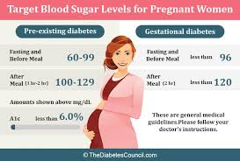
Pre-existing & Gestational [pregnancy-induced]

Slide 45


Slide 46
Other maternal disorders predominantly
related to pregnancy (O20–O29)

Slide 47
Other maternal disorders predominantly related to pregnancy (O20–O29)
Haemorrhage in early pregnancy
Excessive vomiting in pregnancy
Venous complications and haemorrhoids in pregnancy
Infections of genitourinary tract in pregnancy

Slide 48
Other maternal disorders predominantly related to pregnancy (O20–O29)
Diabetes mellitus in pregnancy
Malnutrition in pregnancy
Maternal care for other conditions related to pregnancy (
Low weight gain in pregnancy )
complications of anaesthesia during pregnancy

Slide 49
کلستاز یا خارش بدن در بارداری
بیمار خانم 33ساله PG که با شکایت خارش بدن مراجعه وبستری شده است
بیمار خانم 26 ساله با سابقه بارداری G3P1EP1بدلیل دیابت بارداری مراجعه وبستری شده است.

Slide 51
Maternal care related to the fetus and amniotic cavity and possible delivery problems (O30–O48)

Slide 52
Multiple gestation
Multiple gestation is pregnancy with more than one baby at a time.
Examples include pregnancy with twins, triplets, and quadruplets.
Multiple gestation occurs in approximately three percent of pregnancies.
It is a type of high-risk pregnancy. Delivering twins, triplets, or more requires extra care.

Slide 53
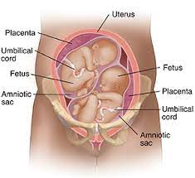
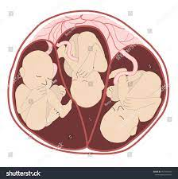
Multiple gestation

Slide 54
بیمار خانم 35سالهPGبا سن حاملگی 30هفته وچندقلویی بدلیل ادامه حاملگی بعداز سقط یک یا چند جنین به مرکز درمانی مراجعه کرده است.
بیمار خانم 30ساله با سابقه بارداریG4P2L1D1AB1با سن حاملگی 33هفته بدلیل آبریزش مراجعه وبستری شده است

Slide 55
Malpresentation
Malpresentation is when your baby is not facing head-first down the birth canal as birth approaches.
The most common type of malpresentation is breech — when your baby's bottom or feet are facing downwards.

Slide 56
Types of Malpresentation
Breech presentation. This is when your baby is lying with their bottom or feet facing down. ...
Face presentation. ...
Transverse lie. ...
Oblique lie. ...
Unstable lie. ...
Cord presentation. ...
Vaginal breech birth. ...

Slide 57
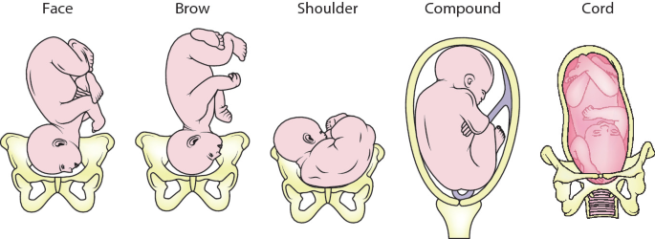
Malpresentation

Slide 58
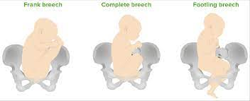
Malpresentation

Slide 59
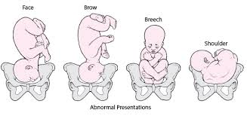
Malpresentation

Slide 60
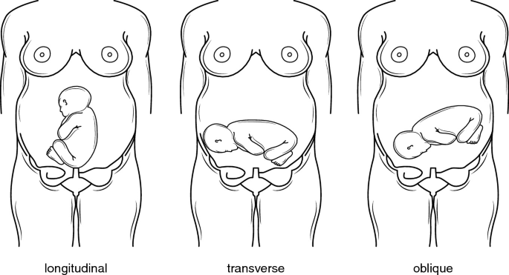
Malpresentation

Slide 61
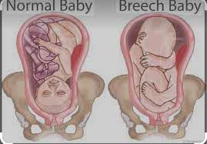
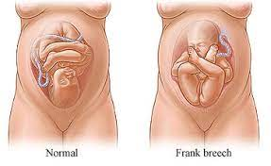
Normal vs breech presentation

Slide 62
بیمار خانم 19ساله PGبا سن بارداری 37 هفته بدلیل درد های زایمانی به مرکزدرمانی مراجعه کرده که دربخش زایمان پرزنتیشن جنین زایمان را دچار مشکل کرده ومریض جهت انجام سزارین به اتاق عمل منتقل میشود.
بیمار خانم 26ساله با سابقه بارداری G2AB138 هفته بدلیل پلاسنتا اکرتا پذیرش وبستری شده است .

Slide 63
known or suspected disproportion
During labor and delivery, a baby has to pass through the narrow opening in the mother's pelvis.
Cephalopelvic Disproportion (CPD) is a condition where the baby has trouble getting through the birth canal because of the size of the baby's head, the baby's position, or the size or shape of the mother's pelvis.

Slide 64
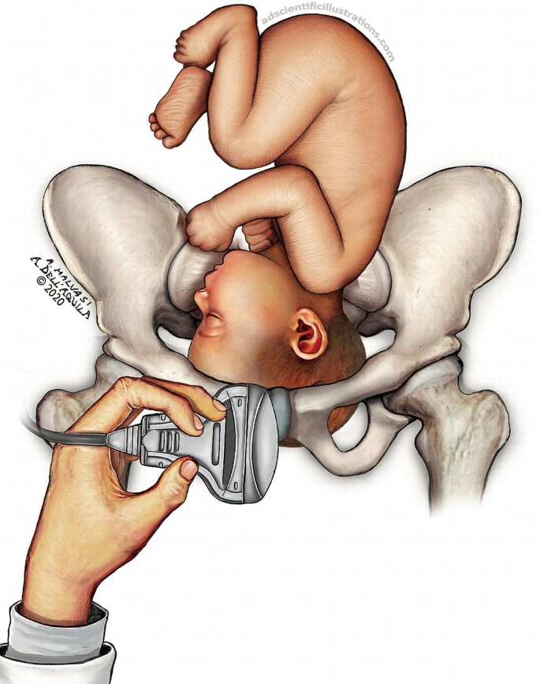
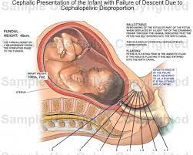
known or suspected disproportion

Slide 65
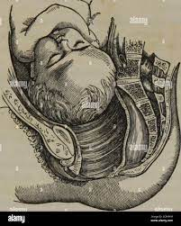
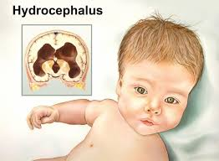
disproportion due to hydrocephalic fetus

Slide 66
congenital malformation of uterus
Congenital uterine anomalies (CUAs) may lead to symptoms such as pelvic pain, prolonged or otherwise abnormal bleeding at the time of menarche,
recurrent pregnancy loss, or preterm birth, and thus
may be identified in patients, including adolescents, who present with these disorders.

Slide 67
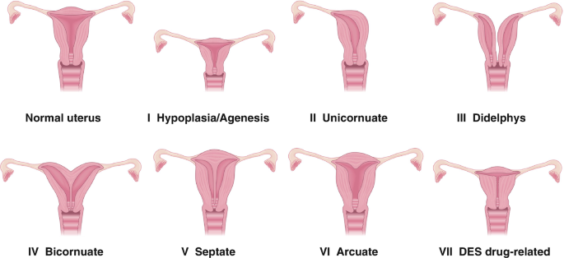
congenital malformation of uterus

Slide 68
congenital malformation of uterus
Examples include :
  uterus didelphys (double uterus),
  arcuate uterus (uterus with a dent on the top part),
  unicornuate uterus (one-sided uterus),
  bicornuate uterus (heart-shaped uterus),
  septate uterus (uterus with partition in the middle), and
  absent uterus

Slide 69
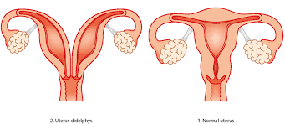
  uterus didelphys (double uterus),

Slide 70
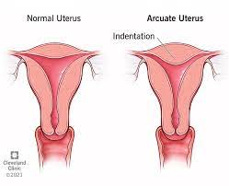
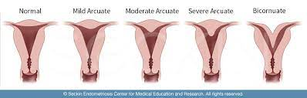
  arcuate uterus (uterus with a dent on the top part),

Slide 71
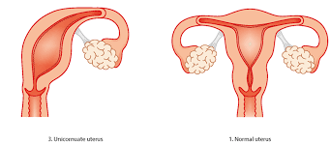
  unicornuate uterus (one-sided uterus),

Slide 72
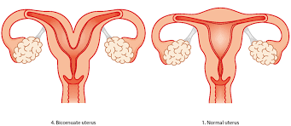
  bicornuate uterus (heart-shaped uterus),

Slide 73
بیمار خانم 22ساله باسابقه نازایی مراجعه کرده بعداز انجام اقدامات بالینی وپاراکلنیکی متوجه رحم دوشاخ شده اند .
بیمار خانم 21ساله PGبدلیل آیوجی آرمراجعه کرده است که بعداز بررسی های بعمل آمده متوجه رحم دوشاخ شده اند.

Slide 74
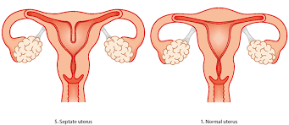
  septate uterus (uterus with partition in the middle), and

Slide 75
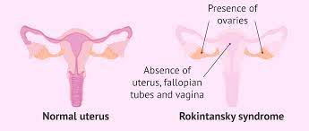
  absent uterus

Slide 76
Isoimmunization
Isoimmunization (Sometimes called Rh sensitization, hemolytic disease of the fetus, Rh incompatibility) What is isoimmunization? A condition that happens when a pregnant woman's blood protein is incompatible with the baby's, causing her immune system to react and destroy the baby's blood cells.

Slide 77
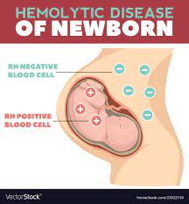
Isoimmunization

Slide 78
Polyhydramnios
Polyhydramnios (pol-e-hi-DRAM-nee-os) is the excessive accumulation of amniotic fluid — the fluid that surrounds the baby in the uterus during pregnancy.
Polyhydramnios occurs in about 1 to 2 percent of pregnancies.

Slide 79
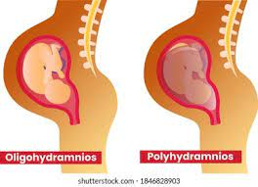
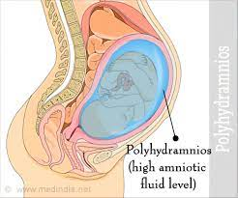
Polyhydramnios

Slide 80
Premature rupture of membranes
Premature rupture of membranes (PROM) is a rupture (breaking open) of the membranes (amniotic sac) before labor begins.
If PROM occurs before 37 weeks of pregnancy, it is called preterm premature rupture of membranes (PPROM).
PROM occurs in about 8 to 10 percent of all pregnancies.

Slide 81
Premature rupture of membranes
If your membranes rupture too soon, the fetus is at risk for premature birth or infection.
If your pregnancy reaches 37 weeks, complications from premature birth are lower.
However, if your baby is born before 37 weeks, they're at higher risk for complications of being born early

Slide 82
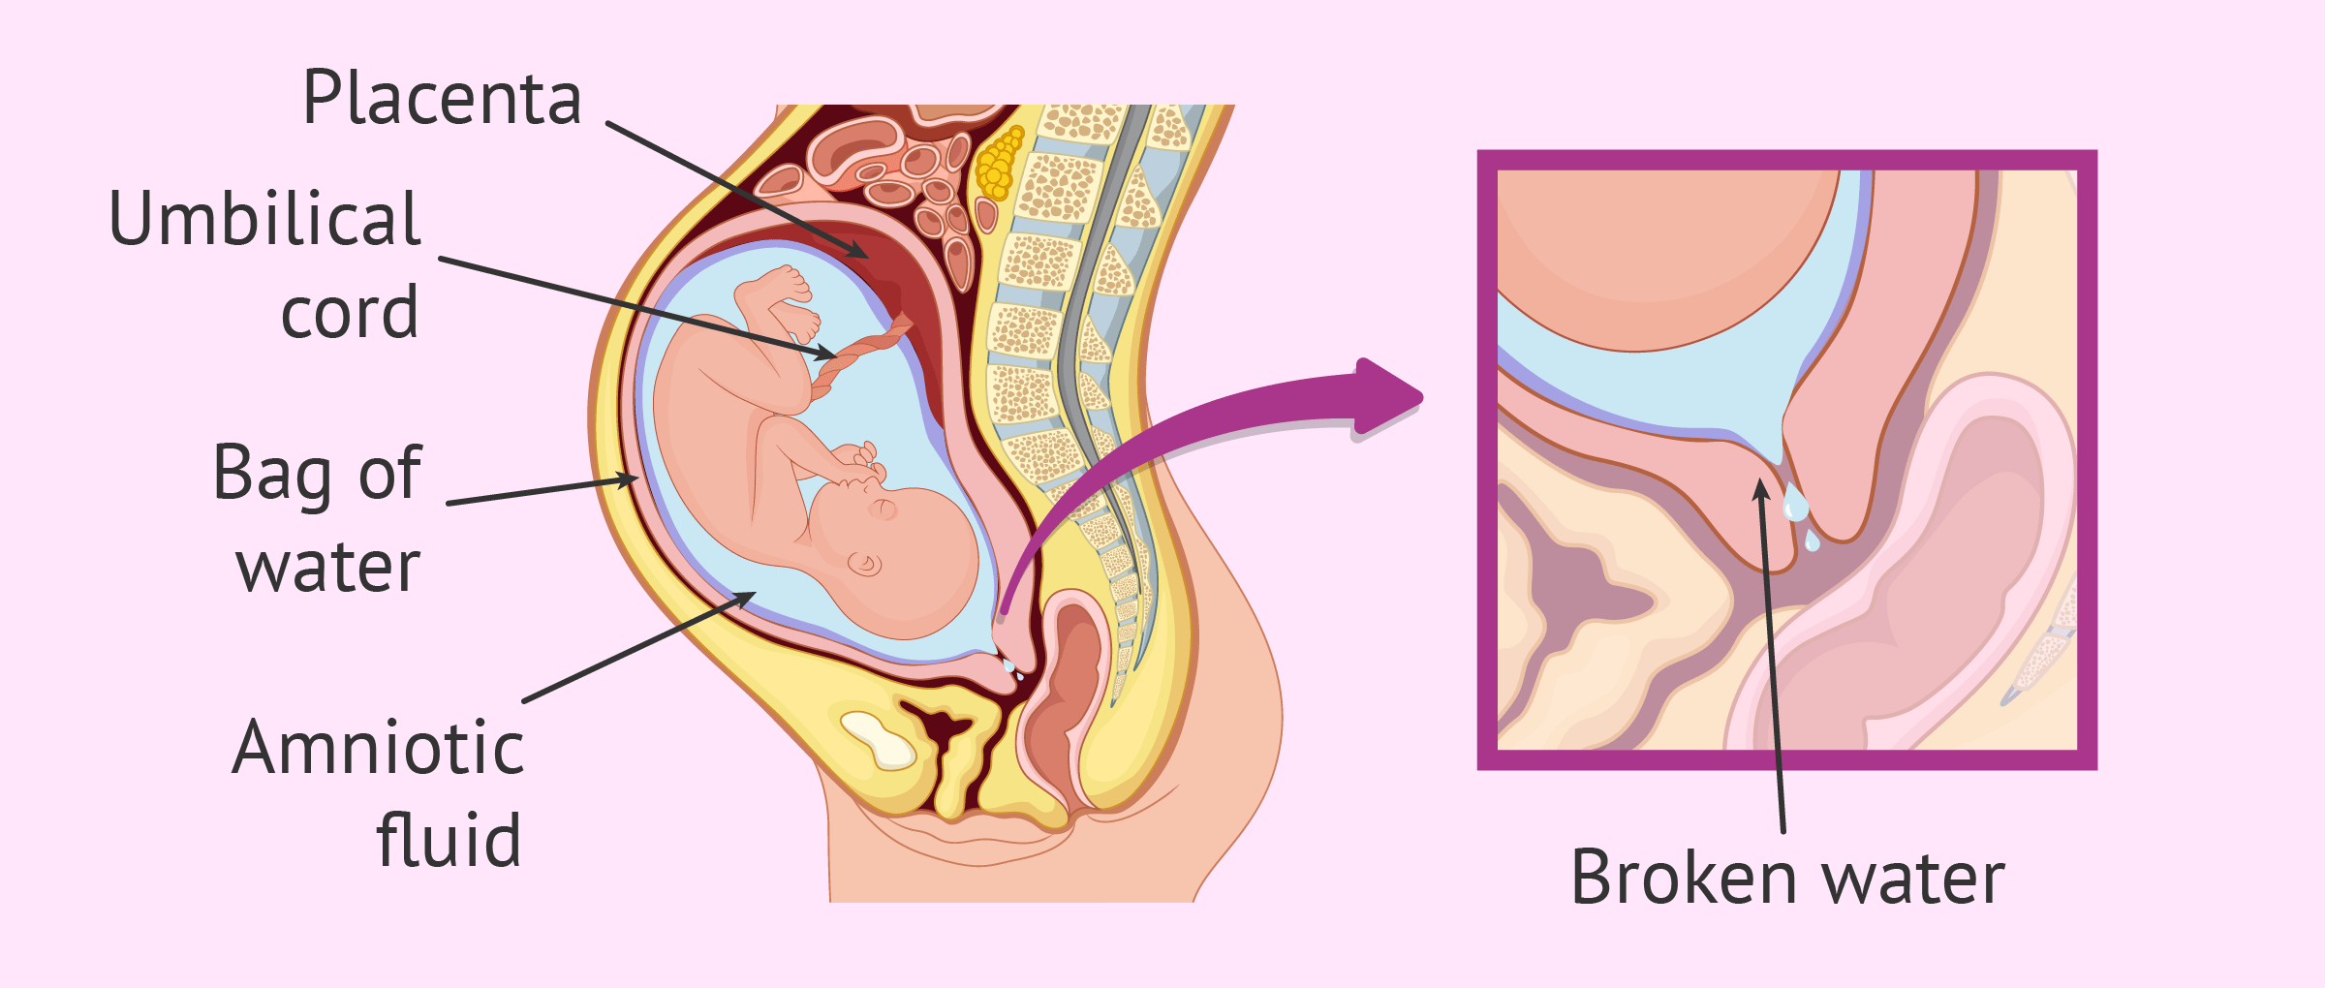
Premature rupture of membranes

Slide 83
placental disorders
Normally, the placenta attaches at the top or side of the uterus.
In some cases, the placenta develops in the wrong location or attaches itself too deeply into the uterine wall.
These placental disorders are called placenta previa, placenta accreta, placenta increta or placenta percreta.

Slide 84
Placenta previa
Placenta previa (pluh-SEN-tuh PREH-vee-uh) is a problem during pregnancy when the placenta completely or partially covers the opening of the uterus (cervix).
The placenta is an organ that develops inside the uterus during pregnancy.
It works to provide oxygen and nutrition to the baby and to remove waste.

Slide 85
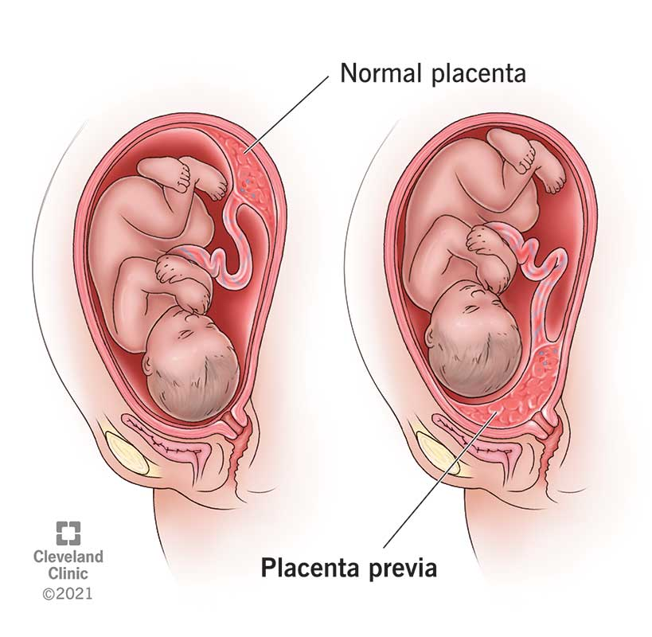
Placenta previa

Slide 86
Placenta accreta
Placenta accreta is a serious pregnancy condition that occurs when the placenta grows too deeply into the uterine wall.
Typically, the placenta detaches from the uterine wall after childbirth.
With placenta accreta, part or all of the placenta remains attached. This can cause severe blood loss after delivery.

Slide 87
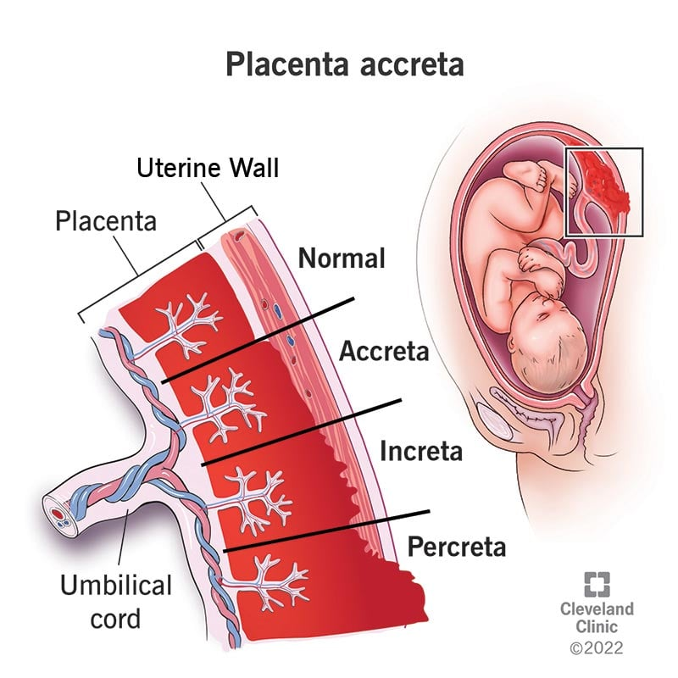
Placenta accrete , increta and percreta

Slide 88
Circumvallate placenta
Circumvallate placenta is a form of extrachorial placenta, with a raised placental margin in an annular shape.
The chorionic plate is smaller than the basal plate, and misalignment between them causes hematoma retention in the placental margin.

Slide 89
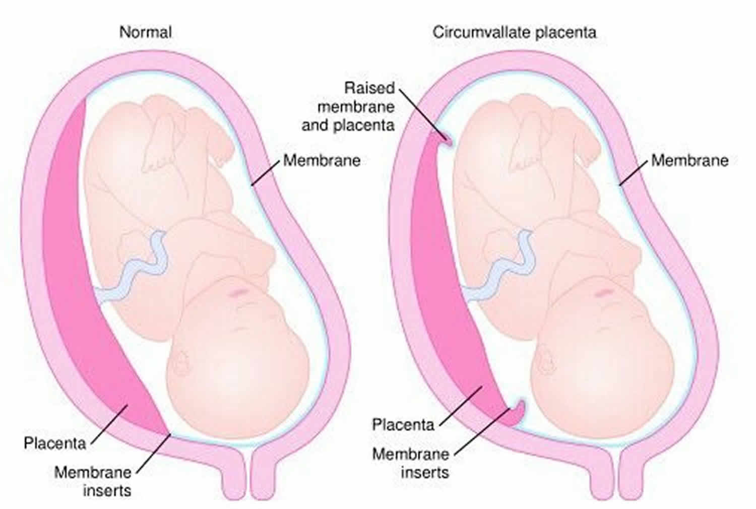
Circumvallate placenta

Slide 90
Placental abruption
(Premature separation of placenta )
Placental abruption occurs when the placenta partly or completely separates from the inner wall of the uterus before delivery.
This can decrease or block the baby's supply of oxygen and nutrients and cause heavy bleeding in the mother.

Slide 91
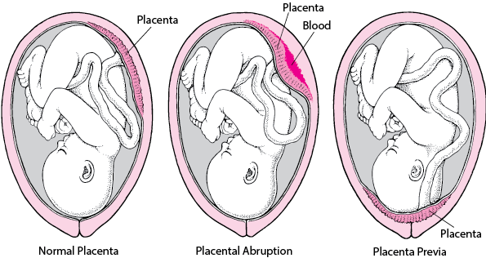
Placental abruption
(Premature separation of placenta )

Slide 92
False labour
Before “true” labor begins, you might have “false” labor pains, also known as Braxton Hicks contractions.

Slide 93
False labour
What is a false Labour?
It's false labor if…
  Contractions don't come regularly and they don't get closer together.
  They stop with walking or resting or with changes in position.
  They are usually weak and don't get stronger, or start strong and get weaker.
  Usually the pain is only felt in the front.

Slide 94
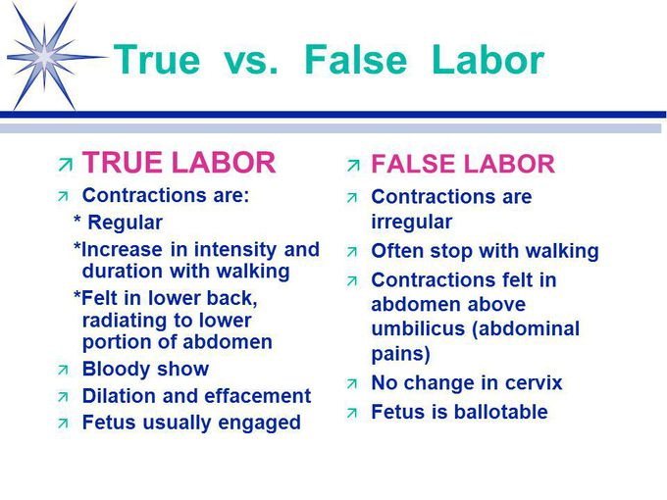
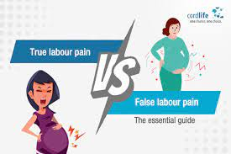
False labour

Slide 95
Prolonged pregnancy
The normal duration of pregnancy is 37 to 42 weeks, which is referred to as "term."
A postterm pregnancy, also called a prolonged pregnancy, is one that has extended beyond 42 weeks or 294 days from the first day of the LMP.
As many as 10 percent of pregnant people give birth postterm.

Slide 96


Prolonged pregnancy

Slide 98
Complications of labour and delivery (O60–O75)

Slide 99
Complications of labour and delivery (O60–O75)
Preterm labour and delivery
Failed induction of labour
Abnormalities of forces of labour
Long labour
  Prolonged first stage of labor
  Prolonged second stage of labor

Slide 100
Complications of labour and delivery (O60–O75)
Obstructed labor
Labour and delivery complicated by …
Perineal laceration during delivery
Other obstetric trauma
Postpartum haemorrhage
Retained placenta and membrans
Complications of anaesthesia during labour

Slide 101
بیمار خانم 21ساله باسابقه بارداری G2P1L1بدلیل پره ترم لیبر مراجعه کرده است وبعداز انجام مراقبتهای بارداری زایمان زود رس انجام شده است.
بیمار خانم 30ساله PGبدلیل دردشکم مراجعه کرده است بعداز انتقال به بخش زایمان دچار ارست دیلاتاسیون سرویکس شده است .
بیمار خانم 18ساله باسابقه بارداری G2P1D1 باحاملگی ترم 39هفته بدلیل درد های زایمانی مراجعه وبستری شده است پس از انتقال به بخش زایمان متوجه میشوند که بیمار مکونیوم میباشد.

Slide 102
بیمار خانم 36ساله به علت خونریزی بدلیل بقایای زایمان اخیربه مرکز درمانی مراجعه وسپس بستری شده است.
بیمار خانم 28ساله با سابقه بارداری G4P2L2EP1AB1بدلیل باقیماندن بقایای سقط اخیر مراجعه کرده است.

Slide 104
Delivery (O80–O84)

Slide 105
Delivery (O80–O84)
Single spontaneous delivery
Single delivery by forceps and vacuum extractor
Single delivery by caesarean section
Other assisted single delivery
Multiple delivery
  Use additional code (O80–O83), if desired, to indicate the method of
  delivery of each fetus or infant.

Slide 106
Single spontaneous delivery
A spontaneous vaginal delivery is a vaginal delivery that happens on its own, without requiring doctors to use tools to help pull the baby out.
This occurs after a pregnant woman goes through labor.
Labor opens, or dilates, her cervix to at least 10 centimeters.

Slide 107
بیمار خانم 32ساله PGباسن حاملگی40هفته بدلیل آبریزش به مرکز درمانی مراجعه وپس از بستری به بخش زایمان جهت انجام زایمان طبیعی منتقل شده است.
بیمار خانم 35ساله با سابقه بارداری G3P2L2بدلیل تشخیص پزشک وادامه حیات مادرنیاز به سزارین هیسترکتومی میباشد.

Slide 108


Single spontaneous delivery

Slide 109

Single spontaneous vertex delivery

Slide 110


Vertex and other cephalic delivery

Slide 111

Vertex and breech delivery

Slide 112
Single delivery by forceps and vacuum extractor
An assisted birth (also known as an instrumental delivery) is when forceps or a ventouse suction cup are used to help deliver the baby.
Ventouse and forceps are safe and only used when necessary for you and your baby.
Assisted delivery is less common in women who've had a spontaneous vaginal birth before

Slide 113

Single delivery by forceps and vacuum extractor

Slide 114
delivery by forceps
A low forceps delivery is one in which the fetal head is at least +2 cm (on a 0 to +5 cm scale of station), but not on the pelvic floor.
Rotation may be greater than or less than 45 degrees.
A mid forceps delivery occurs when the head is engaged, but less than +2 cm station.

Slide 115


delivery by forceps

Slide 116


delivery by forceps

Slide 117
Vacuum extraction delivery
Vacuum extraction is one kind of assisted delivery procedure that can help get your baby through the birth canal when labor is stalled in the second stage.
The vacuum extractor applies suction and traction to the baby's head to help pull it out while you push.

Slide 118

Vacuum extraction delivery

Slide 119
delivery by caesarean section
Cesarean delivery (C-section) is used to deliver a baby through surgical incisions made in the abdomen and uterus.
Planning for a C-section might be necessary if there are certain pregnancy complications.
Women who have had a C-section might have another C-section.

Slide 120

delivery by caesarean section

Slide 121

delivery by caesarean section

Slide 122
Assisted breech delivery
Assisted breech delivery: This is the most common type of vaginal breech delivery.
The infant is allowed to spontaneously deliver up to the umbilicus, and then maneuvers are initiated to assist in the delivery of the remainder of the body, arms, and head.

Slide 123


Assisted breech delivery

Slide 124
version and extraction delivery
External cephalic version (sometimes called ECV or EV) is a procedure healthcare providers will use to rotate a baby from a breech position to a head-down position.
A breech position is when a baby's feet or buttocks present first or horizontally across your uterus (called a transverse lie).

Slide 125

version and extraction delivery

Slide 126
Multiple delivery
The term multiple births refers to the presence of more than one fetus in the uterus.
The number of twin, triplet, and other multiple births has been increasing during the last two decades.
As many as 1 of 30 deliveries involves more than one fetus.

Slide 127
Multiple delivery
O84 : Multiple delivery
Use additional code (O80–O83), if desired, to indicate the method of delivery of each fetus or infant.

Slide 128


Multiple delivery

Slide 129
Complications predominantly related to the puerperium (O85–O92)

Slide 130
Complications predominantly related to the puerperium (O85–O92)
Puerperal sepsis (Use additional code (B95–B98) , if desired, to identify infectious agent. )
Other puerperal infections
Venous complications and haemorrhoids
Obstetric embolism
Complications of anaesthesia
Complications of the puerperium (NEC)
Infections of breast
disorders of breast and lactation

Slide 131
بیمار خانم 24ساله باسابقه بارداری G2P1D1یک هفته پیش زایمان کرده است به دلیل تب وعفونت به مرکز درمانی مراجعه کرده است.

Slide 132
Other obstetric conditions, not elsewhere classified (O94–O99)

Slide 133
Other obstetric conditions, not elsewhere classified (O94–O99)
Sequelae of complication of pregnancy
Obstetric death of unspecified cause
Death from any obstetric cause
Death from sequelae of obstetric causes
Maternal infectious and parasitic diseases classifiable elsewhere but complicating pregnancy
Other maternal diseases classifiable elsewhere but complicating pregnancy

Slide 134

The End

